Slide 1


<Name>
<Date>

Slide 2

Outline
Executive Summary
Introduction
Methodology
Results
Conclusion
Appendix

Slide 3
Executive Summary
Summary of methodologies
Data Collection
Data Wrangling
Exploratory Data Analysis (EDA) with Visualization and SQL queries
Interactive Visuals and Dashboard with Folium and Plotly Dash
Predictive Analysis (Classification)
Summary of all results
EDA results
Interactive Demo results
Predictive Analysis Results

Slide 4
Introduction
Project background and context
SpaceX is the most successful commercial space travel company allowing civilians the ability to go to space. Advertised at 62 million dollars, compared to the cost of over 165 million from other providers SpaceX is considered the more cost-effective option. This is largely due to their ability to reuses first stage rockets. Determining if the first stage lands will help us calculate the cost of a launch. Based on the data obtained and methods used in this project, we will predict if this reuse is possible.
Questions?
How do variables such as launch site location, payload mass, number of launches, and orbits effect success rate of first stage landings?
Is the success rate of these landings improving over time?
What predictive model produces the best results for the binary classification problem this case presents?

Slide 5

Section 1

Slide 6
Methodology
Executive Summary
Data collection methodology:
SpaceX API calls and web scraping from the SpaceX Wikipedia
Perform data wrangling
Filter data
Deal with missing values
Implement One Hot Encoding to prepare data for classification
Perform exploratory data analysis (EDA) using visualization and SQL
Perform interactive visual analytics using Folium and Plotly Dash
Perform predictive analysis using classification models.
Building of multiple models, tuning, and evaluating to ensure maximum accuracy.

Slide 7
Data Collection
Data sets were obtained from the SpaceX API as well as the SpaceX Wikipedia.
Both data sets, obtained through data collection methods like web scraping, ensured complete information to be used for deatailed analysis.

Slide 8
Data Collection – SpaceX API
The public SpaceX API was used to retrieve data.
https://github.com/mboettger32/IBM-Applied-Data-Science-Captone/blob/94194dc5cca479a8712ee0d5a4c9d72a717a5d66/jupyter-labs-spacex-data-collection-api%20(1)%20(1).ipynb
Request data from API
Extract and parse data into data frame
Deal with missing(N/A) values
Export data to CSV

Slide 9
Data Collection - Scraping
Request data from Wiki
Create BeautifulSoup Object from response
Extract all column and variable names
SpaceX launch data obtained from their Wikipedia
https://github.com/mboettger32/IBM-Applied-Data-Science-Captone/blob/94194dc5cca479a8712ee0d5a4c9d72a717a5d66/jupyter-labs-webscraping%20(1).ipynb
Create dataframe and export to CSV
Construct data into dictionary
Parse html tables

Slide 10
Data Wrangling
EDA
Exploratory Data Analysis was performed on the data.
Calculated number of launches at each site, the number and occurrence of each orbit, and the number and occurrence of mission outcome per orbit type.
Create landing outcome label based on success.
https://github.com/mboettger32/IBM-Applied-Data-Science-Captone/blob/94194dc5cca479a8712ee0d5a4c9d72a717a5d66/3)jupyter-spacex-data_wrangling_jupyterlite.jupyterlite.ipynb
Calculations
Label Landing Outcome
Export to CSV

Slide 11
EDA with Data Visualization
Charts Created
Flight Number vs. Payload Mass, Flight Number vs. Launch Site, Payload Mass vs. Launch Site, Orbit Type vs. Success Rate, Flight Number vs. Orbit Type, Payload Mass vs Orbit Type and Success Rate Yearly Trend.
Scatter Plots
To show variable relationships.
Bar Charts
To compare discrete categories based on a measured value.
Line Charts
To visualize trends in data over time.
https://github.com/mboettger32/IBM-Applied-Data-Science-Captone/blob/94194dc5cca479a8712ee0d5a4c9d72a717a5d66/5)jupyter-labs-eda-dataviz.ipynb.jupyterlite.ipynb

Slide 12
EDA with SQL
SQL Queries Performed
Displaying the names of the unique launch sites in the space mission
Displaying 5 records where launch sites begin with the string ‘CCA’
Displaying the total payload mass carried by boosters launched by NASA (CRS)
Displaying average payload mass carried by booster version F9 v1.1
Listing the date when the first successful landing outcome in ground pad was achieved
Listing the names of the boosters which have success in drone ship and have payload mass greater than 4000 but less than 6000L
Listing the total number of successful and failure mission outcomes
Listing the names of the booster versions which have carried the maximum payload mass
Listing the failed landing outcomes in drone ship, their booster versions and launch site names for the months in 2015
Ranking the count of landing outcomes (such as Failure (drone ship) or Success (ground pad)) between the date 2010-06-04 and 2017-03-20 in descending order
https://github.com/mboettger32/IBM-Applied-Data-Science-Captone/blob/94194dc5cca479a8712ee0d5a4c9d72a717a5d66/4)jupyter-labs-eda-sql-coursera_sqllite.ipynb

Slide 13
Build an Interactive Map with Folium
Markers
Added markers with circle, popup label and text label of NASA Space Center suing coordinates.
Marked all launch sites to show proximity to coastline.
Colored Markers
Green and red markers indicated success rate of launch sites.
Distance Lines
Showed distance between selected launch site to coastlines.
https://github.com/mboettger32/IBM-Applied-Data-Science-Captone/blob/94194dc5cca479a8712ee0d5a4c9d72a717a5d66/6)jupyter_launch_site_location.jupyterlite.ipynb

Slide 14
Build a Dashboard with Plotly Dash
Dropdown List
Launch site selection
Pie Chart
Shows total launches as well as success vs failure at selected site.
Slider
To select payload range
Scatter Chart
Correlate payload mass to success rate for various booster versions.
https://github.com/mboettger32/IBM-Applied-Data-Science-Captone/blob/94194dc5cca479a8712ee0d5a4c9d72a717a5d66/7)spacex_dash_app.py

Slide 15
Predictive Analysis (Classification)
Comparison of four models to achieve best results
Logistic Regression
Support Vector Machine
Decision Tree
K Nearest Neighbors
Data Prep and Standardization
Build each model type and tune hyperparameters
Compare model accuracy for best result

Slide 16
Results
Exploratory data analysis results
Interactive analytics demo in screenshots
Predictive analysis results

Slide 17

Section 2

Slide 18
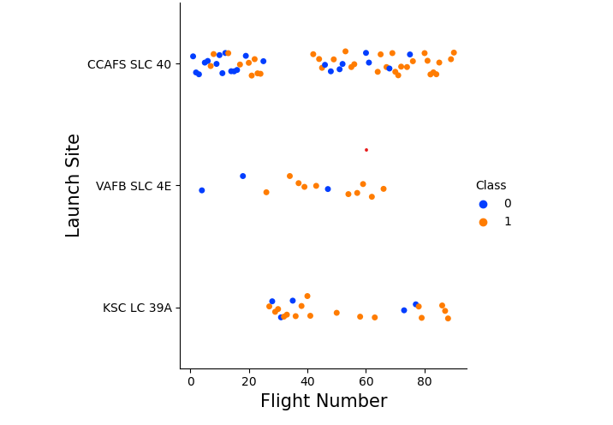
Flight Number vs. Launch Site
Explanation
The earliest flights all failed while the latest flights all succeeded.
The CCAFS SLC 40 launch site has about a half of all launches.
VAFB SLC 4E and KSC LC 39A have higher success rates.
It can be assumed that each new launch will have a higher rate of success.

Slide 19
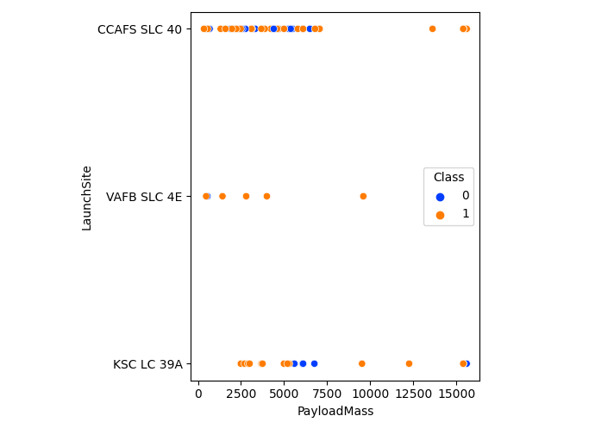
Payload vs. Launch Site
Explanation
CCAFS SLC 40’s flights success do not seem directly correlated to payload mass.
Higher payload mass may only slightly influence success in a positive way.

Slide 20
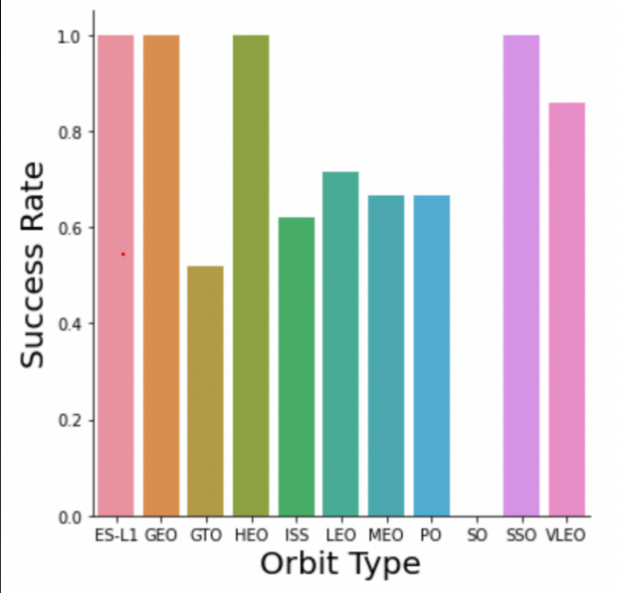
Success Rate vs. Orbit Type
Orbits with 100% Success Rate
ES-L1, GEO, HEO, SSO
Orbits with 0% Success Rate
SO
All other Orbit Types have Success Rates Between 50% and 85%

Slide 21
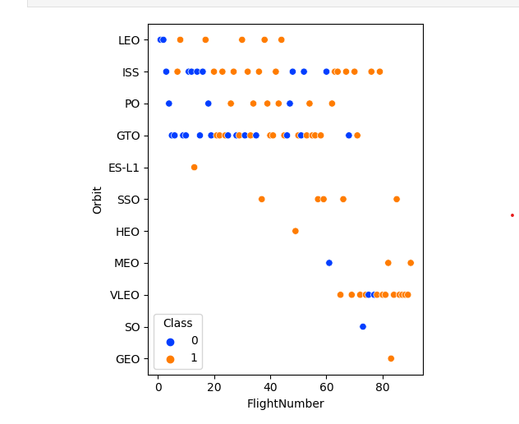
Flight Number vs. Orbit Type
LEO is the only Orbit Type with a success rate that seems to correlate to flight number.
All others show no distinct correlation.

Slide 22
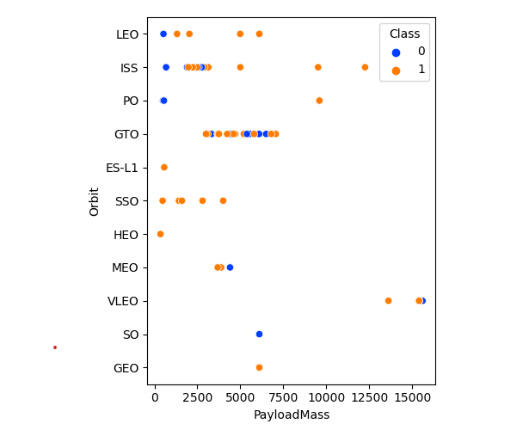
Payload vs. Orbit Type
Heavier Payloads have higher success with Polar, LEO, and ISS orbit types.
GTO on the other hand, cannot be distinguished.

Slide 23
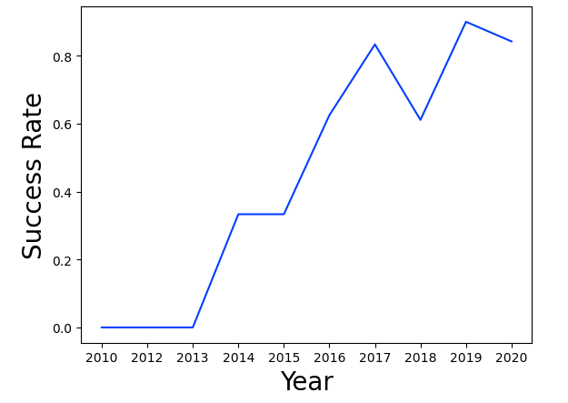
Launch Success Yearly Trend
Explanation
There has been an overall positive trend in success rate since 2013.

Slide 24
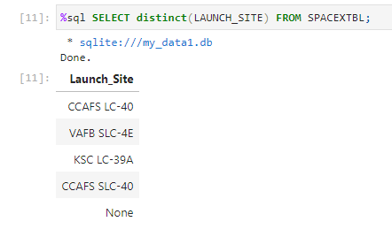
All Launch Site Names
The following SQL query was used to find the names of each launch site.

Slide 25
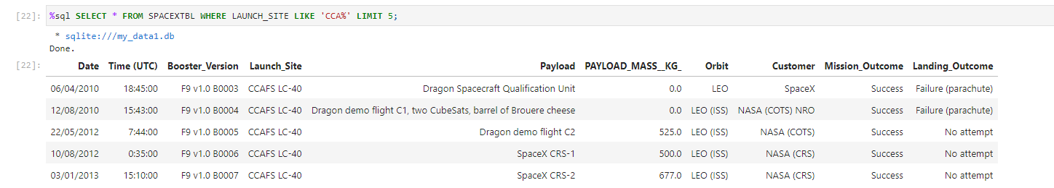
Launch Site Names Begin with 'CCA'
The following query displays 5 launches that where the launch site begins with the string ‘CCA’.

Slide 26
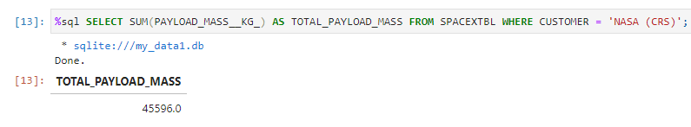
Total Payload Mass
Query to calculate total payload mass of all NASA launches.

Slide 27
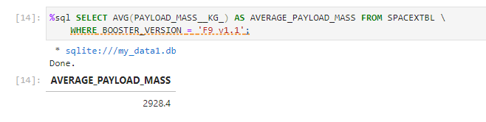
Average Payload Mass by F9 v1.1
Query calculates the average payload mass carried by booster version F9 v1.1

Slide 28
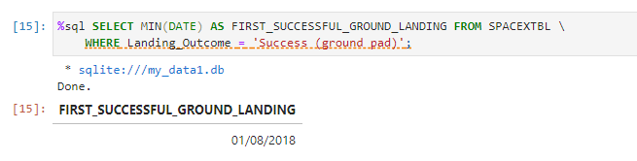
First Successful Ground Landing Date
Query to find the date of the first successful landing outcome on ground pad

Slide 29
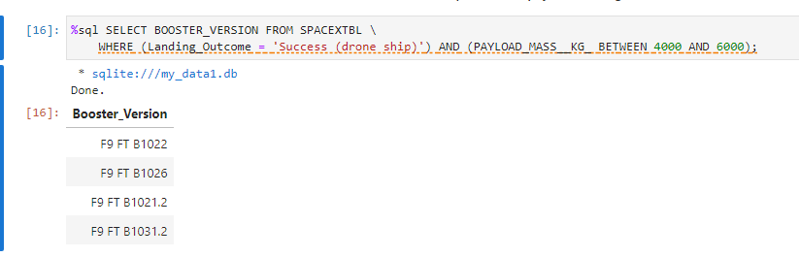
Successful Drone Ship Landing with Payload between 4000 and 6000
Query lists the names of boosters which have successfully landed on drone ship and had payload mass greater than 4000 but less than 6000

Slide 30
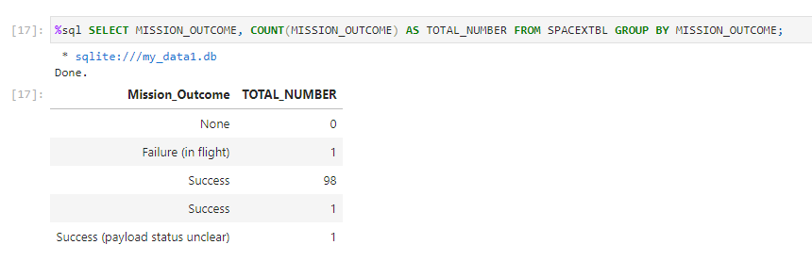
Total Number of Successful and Failure Mission Outcomes
Calculate the total number of successful and failure mission outcomes

Slide 31
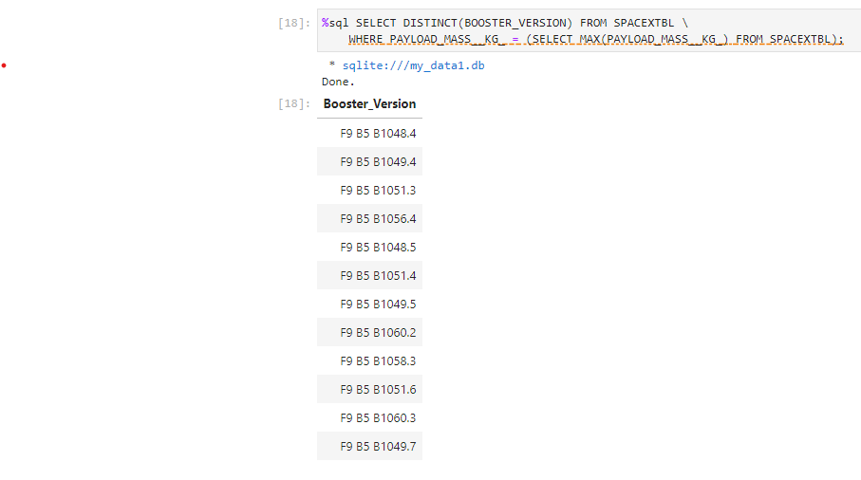
Boosters Carried Maximum Payload
Lists the names of the booster which have carried the maximum payload mass

Slide 32
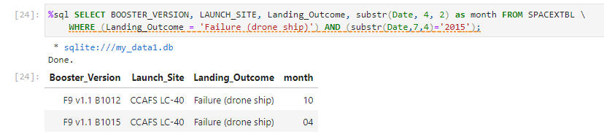
2015 Launch Records
Lists the failed landing outcomes in drone ship, their booster versions, and launch site names for in year 2015

Slide 33
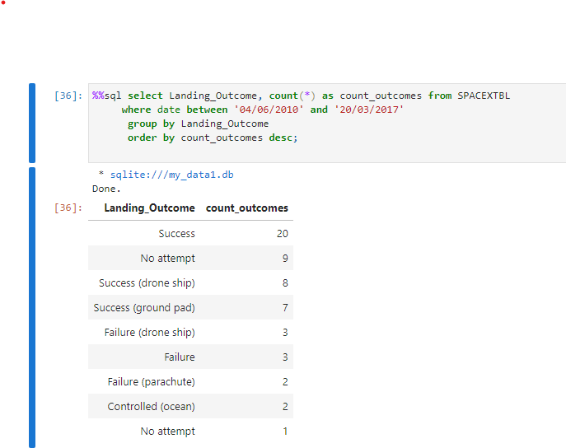
Rank Landing Outcomes Between 2010-06-04 and 2017-03-20
Ranks the count of landing outcomes between the date 2010-06-04 and 2017-03-20, in descending order.

Slide 34

Section 3

Slide 35
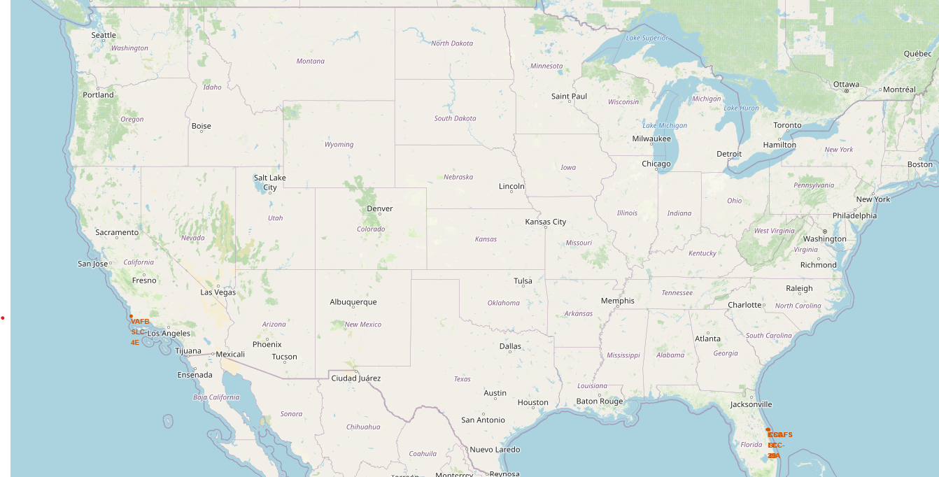
Launch Sites Location Markers
All launches are in close proximity to the coast and in the southern half of the United States.
This also makes them closer to the equator, allowing for the space craft to reach desired speed much quicker due to the Earth’s rotation and inertia.

Slide 36
Color Coded Launch Markers
The color labeled launch marker allow us to quickly identify launch sites with high success rates.
The higher the ratio of green markers to red indicates high success rate at a location.
In this example, we can see launch site KSC LC-39A has a very high success rate.

Slide 37
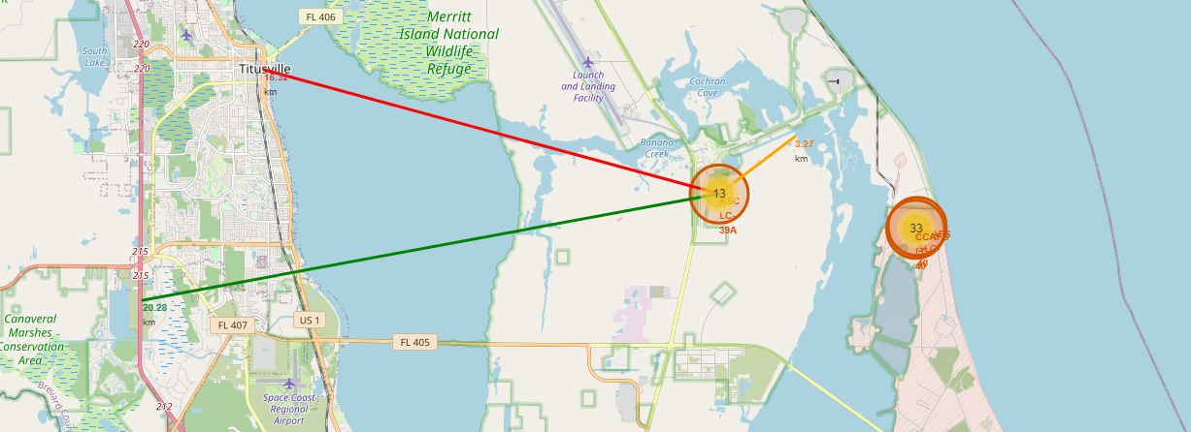
Distances from Launch Sites
These launch sites are relatively close to the coast, which allows room for error to the ocean, but they also have proximity to populated areas such as Titusville. This may be dangerous if a launch were to go wrong in the that direction.

Slide 38

Section 4

Slide 39
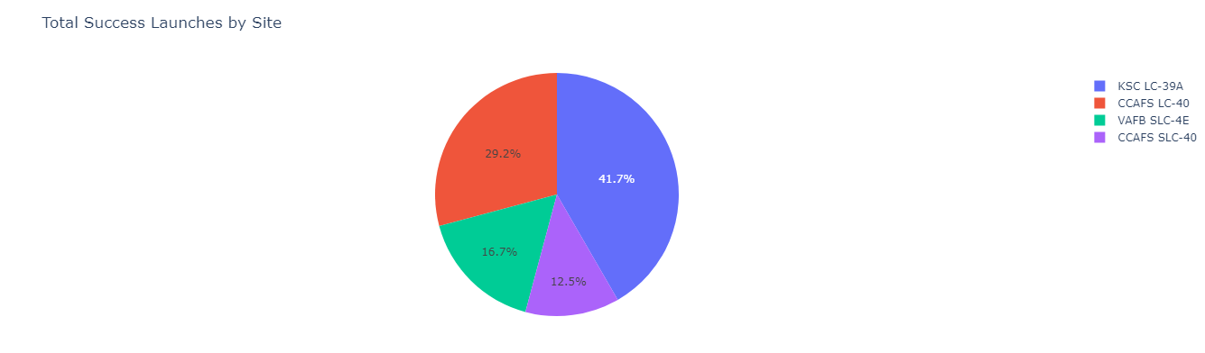
Successful Launches by Site
The pie chart shows that launch site KSC LC-39A the greatest percentage of successful launches out of all the sites.

Slide 40
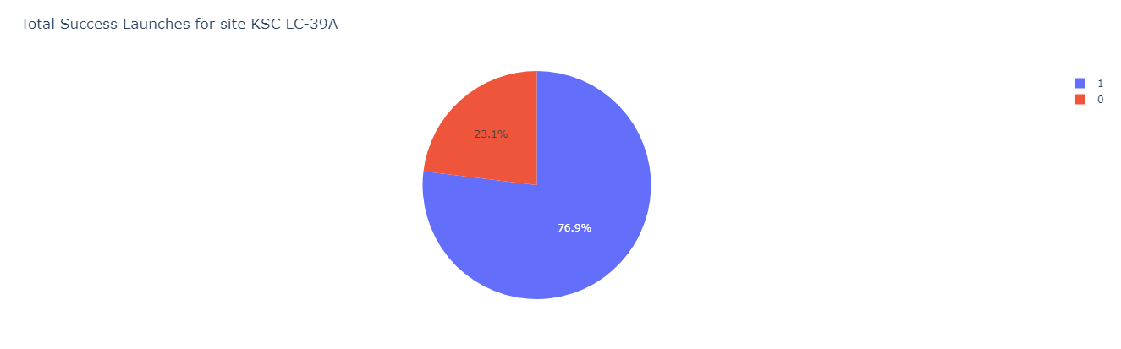
KSC LC-39A Success Ratio
The launch site with the most successful launches, also has w very high success rate with 76.9% or 10 out of 13 successful launches.

Slide 41
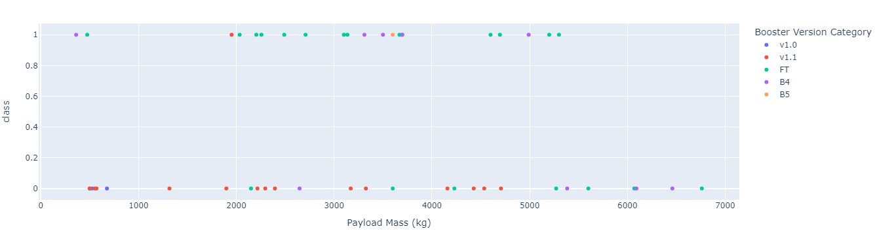
Payload Mass and Success Correlation
Regardless of Booster Version, the chart shows that the most successful payload range is between 2000 and 5050kg.

Slide 42

Section 5

Slide 43
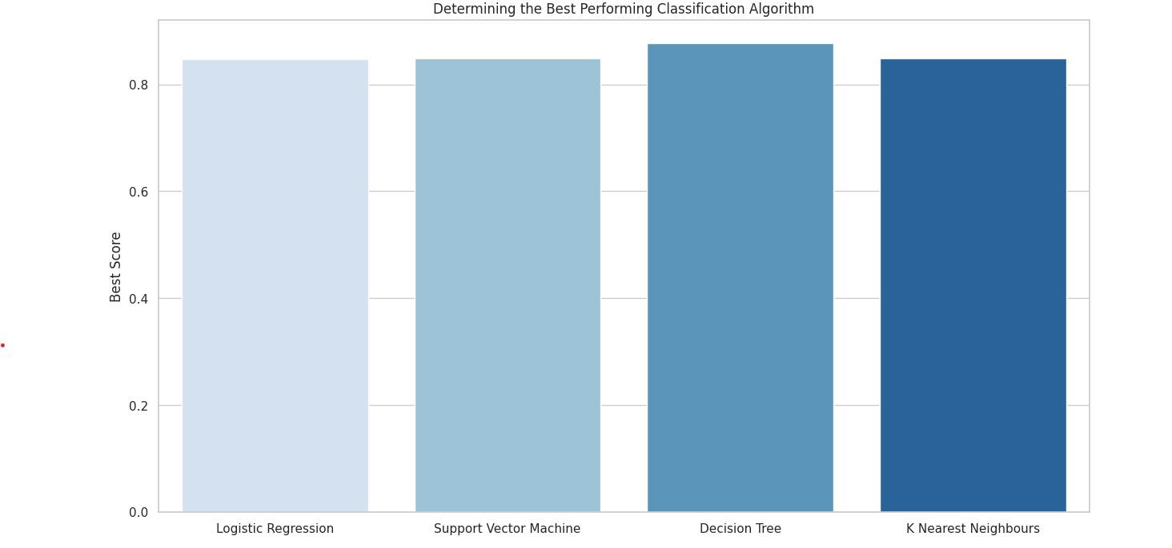
Classification Accuracy
Based on the bar chart shown we can see that the decision tree model had the best accuracy score of 87.67%.

Slide 44
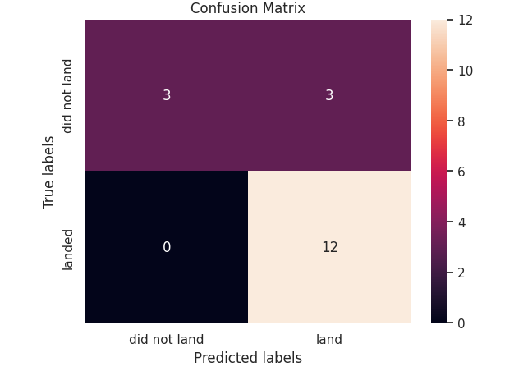
Confusion Matrix
We can see that the Decision Tree model is very good at determining True Positives.
There is however a major issue with false positives.

Slide 45
Conclusions
The Decision Tree model was the model that performed best on this set of data.
Launches have the highest rate of success with payloads between 2000 and 5050kg.
Success rate of launches has steadily increased with time.
KSC LC-39A is the most successful launch site to date, possibly due to its proximity to the equator.

Slide 46


